Slide 1
Trigger

Slide 2
Types of trigger
Scheduled trigger: invoke the pipeline on pre-specified clock time
Tumbling window trigger: Operates on periodical interval, while also retaining the state
Storage event based trigger: runs the pipeline against events happening in a storage account, such as the arrival of a file, or the deletion of file in blob storage
Custom event based trigger: process and handles custom articles in event grid

Slide 3
Scheduled trigger
Click on the monitor-> trigger -> new
Mention the proper start date, time zone, recurrence
Click on the advanced recurrence options -> Execute at these time will arrange the various time combinations for execution
From the recurrence select the week and time for the execution

Slide 4
Storage event-based trigger
Data integration scenarios often requires customer to trigger pipelines based on the events happening on the storage accounts such as the arrival of a file in Azure Blob Storage account
Invoke pipeline against events happening in a storage account, such as the arrival of the file or deletion of a file in Azure Blob storage account
Data factory pipelines natively integrate with Azure Event Grid, which lets you trigger pipelines on such events

Slide 5
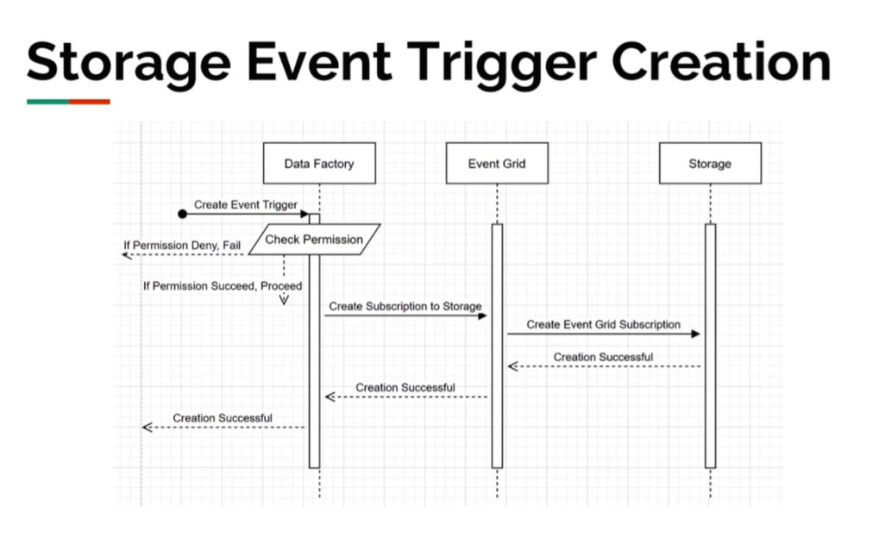

Slide 6
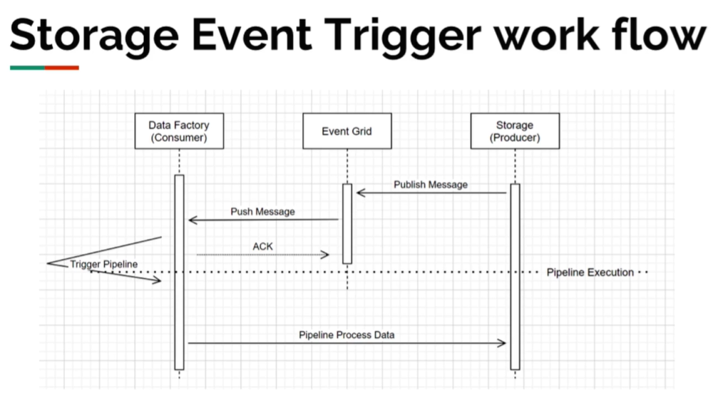

Slide 7
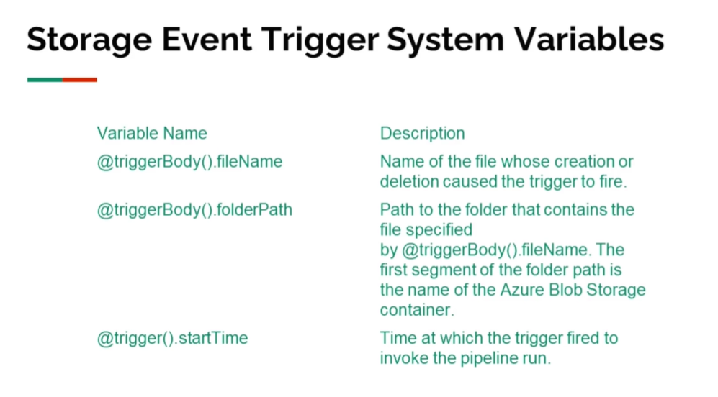

Slide 8
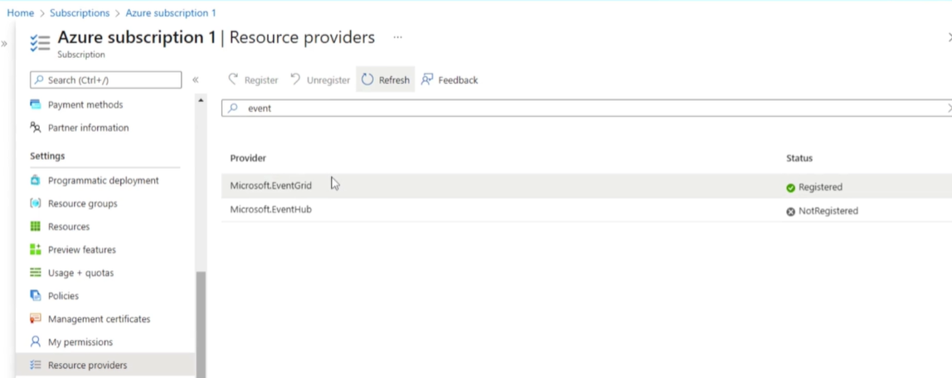
Steps to create event-grid
Go to Azure subscription -> resource provider
Search for event grid from resource provider
Select the Microsoft event grid and click on register
Create a landing folder in a blob storage where files land from different sources

Slide 9
Create the new trigger
Create a new trigger with type storage
Select the event blob created/ blob deleted
Ignore empty blobs as yes
Add trigger to the pipeline and publish the same
Go to landing folder from blob storage and upload the new file
Go to ADF-> monitor and see the trigger invoked is successful with one event

Slide 10

Tumbling trigger
Tumbling window are a series of fixed sized, non-overlapping and contiguous time intervals
This one is used to handle back fail senarios
These are triggers which fires at a periodic time interval from specified start time, while retaining state.
Tumbling window trigger has one to one relationship with a pipeline and can only reference a singular pipeline
Two parameters related to tumbling window

Slide 11
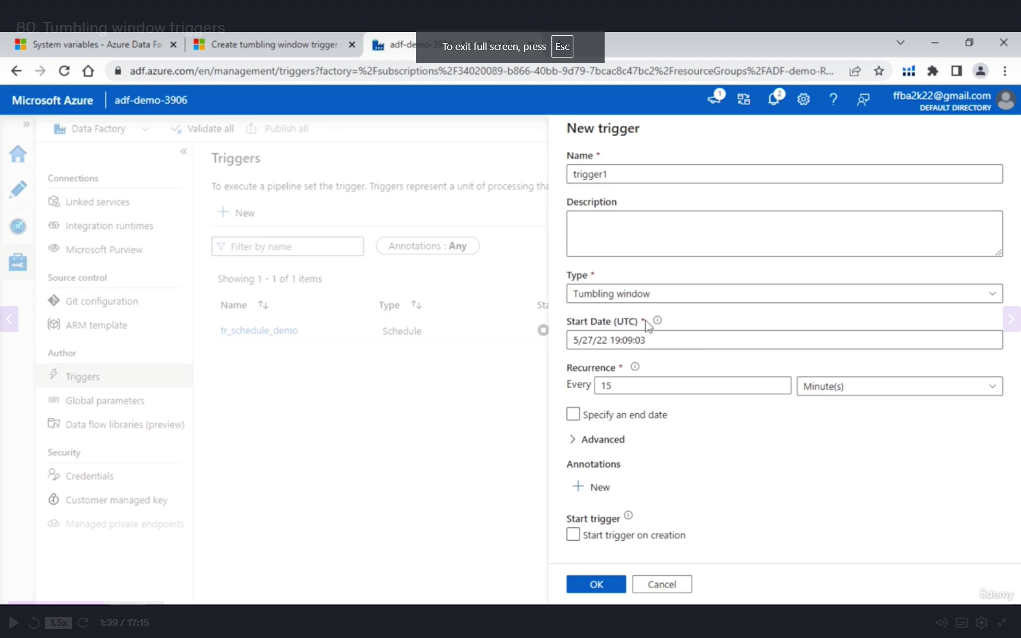

Slide 12
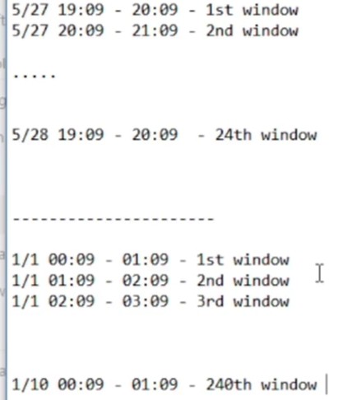

Slide 13
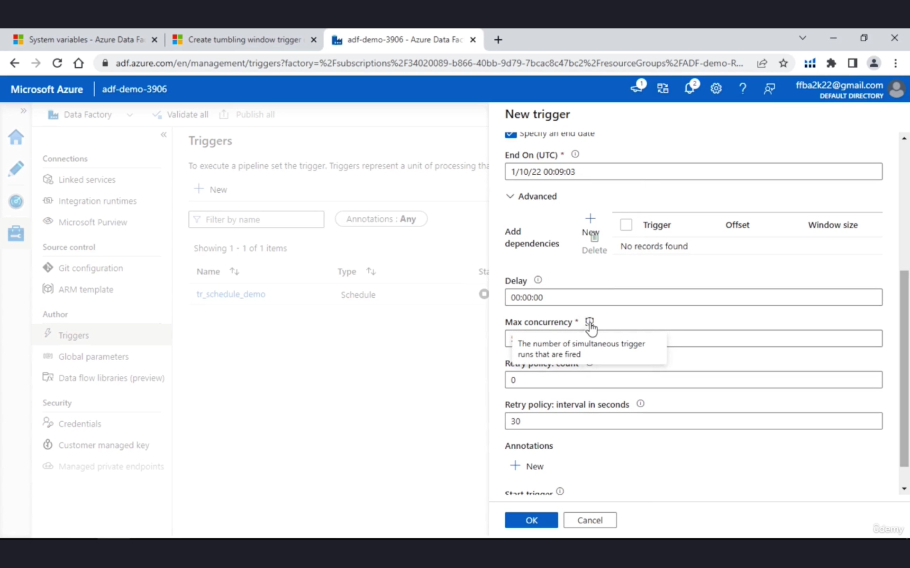

Slide 14
Use case
Suppose there are two pipelines pl1 and pl2
Pl1 is used for transactional processing of the data
Pl2 is used to generate the summary based on pl1 data
Here we are creating two triggers
Pl1 -> trig B
Pl2 -> trig A
Once the trigger B is invoked then only trig A will be executed
In some cases , trigB may get delay and trigA should be on hold.
To complete the same add dependencies.
Pass the proper trigger name

Slide 15
